Slide 1
HTML5

Slide 2
New elements
HTML5 offers new elements for better document structure:
article
aside
bdi
Details, summary
dialog
figcaption
figure
footer
header
main
mark
nav
section
time

Slide 3
article
The <article> tag specifies independent, self-contained content.
An article should make sense on its own and it should be possible to distribute it independently from the rest of the site.
Potential sources for the <article> element:
Forum post
Blog post
News story
Comment

Slide 4
<!DOCTYPE html>
<html>
<body>
<article>
<h1>Google Chrome</h1>
<p>Google Chrome is a free, open-source web browser developed by Google, released in 2008.</p>
</article>
<p><strong>Note:</strong> The article tag is not supported in Internet Explorer 8 and earlier versions.</p>
</body>
</html>

Slide 5
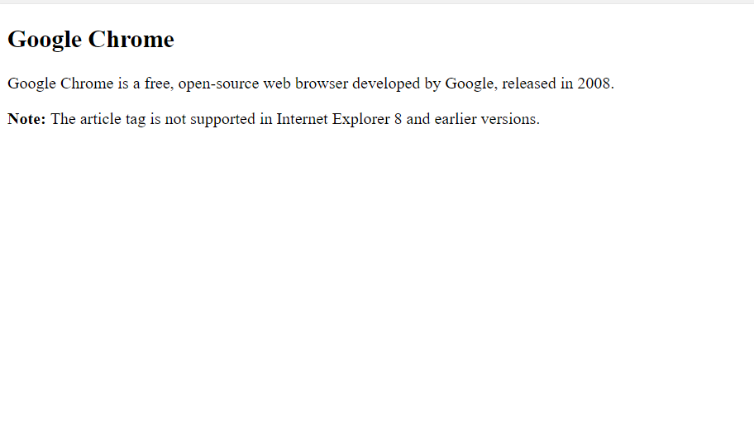
Output-

Slide 6
2. aside
The <aside> tag defines some content aside from the content it is placed in.
The aside content should be related to the surrounding content.
The <aside> content could be placed as a sidebar in an article.

Slide 7
<!DOCTYPE html>
<html>
<body>
<p>My family and I visited The Epcot center this summer.</p>
<aside>
<h4>Epcot Center</h4>
<p>The Epcot Center is a theme park in Disney World, Florida.</p>
</aside>
<p><strong>Note:</strong> The aside tag is not supported in Internet
Explorer 8 and earlier versions.</p>
</body>
</html>

Slide 8
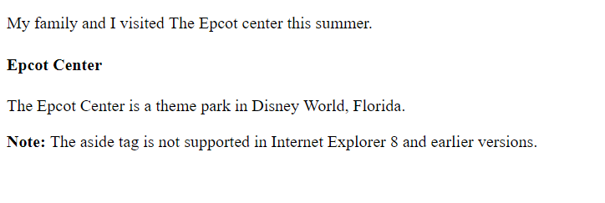
Output-

Slide 9
3. BDI tag
It stands for Bidirectional isolate element.
The BDI tag isolates a part of text that might be formatted in a different direction from other outside text.
This tag is new in HTML5 and use for languages like Arabic or Hebrew.
<!doctype html>
<html>
<head>
<title>BDI tag</title>
</head>
<body>
<h1>Bidirectional Element</h1>
<p dir="rtl"> Example of <bdi>Bidirectional</bdi> </p>
</body>
</html>

Slide 10
4. Details tag
The <details> tag specifies additional details that user can view or hide on demand.
The <details> tag can be used to create an interactive widget that the user can open and close. Any sort of content can be put inside the <details> tag.
The content of a <details> element should not be visible unless the open attribute is set.
Not supported in Internet explorer.

Slide 11
5. Dialog
The <dialog> tag defines a dialog box or window.
The <dialog> element makes it easy to create a popup dialog on a web page.
Attribute- open

Slide 12
6. <figure> tag
The <figure> tag is new in HTML5.
The figure tag specifies self-contained contents like illustration, diagrams, photos, code listings etc.
<figcaption>
The <figcaption> tag defines a caption for a <figure> element.
Before <figure> tag came we were not able to add title for images, code and diagram.
The benefit of adding figure title is if we have figure title then when in search engine the figure title is searched then it can find it and show the website link.

Slide 13
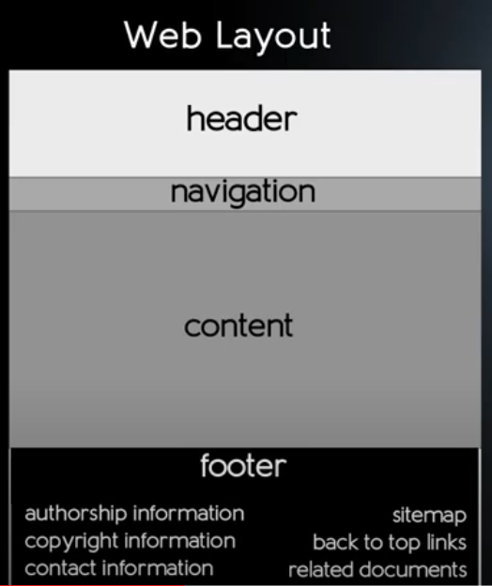
Web layout

Slide 14
7. <Header> tag-
The header tag is new in html5.
In html 4.0 - <div id=“header”> </div>
The <header> element represents a container for introductory content or a set of navigational links.
8. <footer> tag-
The footer tag is new in HTML5.
In HTML 4.0
<div id=“footer”>
The footer tag defines a footer for a document or section.

Slide 15
8. <main> tag
It specifies the main content of the document.
The content inside the <main> element should be unique to the document. It should not contain any content that is repeated across the document such as sidebars, navigation links, copyright information, sit logos and search form.
There must not be more than one <main> element in a document. The main element must not be a descendant of an <article>, <aside>, <footer>, <header> or <nav> element.

Slide 16
9. <mark> tag
The <mark> tag defines marked text.
Use the <mark> tag if you want to highlight parts of your text.

Slide 17
10. <nav> tag
The <nav> tag is new in HTML5.
The <nav> tag defines a set of navigation links.
In most cases navigation shown below the header. But it can also be used in the side bar. Navigation is also displayed on all pages of your website just like header. So that you can access important parts like Home, Services etc. from any place in the website.
It is not having any local attribute but it can be used with global attributes like id, class etc.

Slide 18
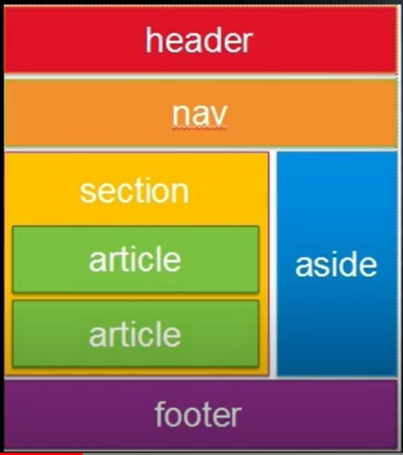
11. <section> tag

Slide 19
<section> tag defines a group or section in our web page.
If we have headings, paragraphs regarding a particular topic then these paragraphs related to a topic can be kept under that section only.
In our web page different sections can be possible like- about us, copyright, services.
What is the difference between section and division?
Division is a blank element. In that also we can keep information related to a topic. But we should keep within section only because section defines a group for the related information about a particular topic.
The main difference between division and section is that when we search our website in google search engine then related topic sections are easily searched by search engine but it can not search the divisions.

Slide 20
<time> tag
It is used to specify time and date in different formats.
If we are using this tag then it will be easily detected by the search engine to find our web page.

Slide 21
<meter> tag
The <meter> tag defines a scalar measurement within a known range or a fractional value. This is also known as gauge.
To graphically present a known value or range in a web page we are using this tag.
It contains a number of attributes like value, min, max, low, high, optimum etc.
The required value specifies the current or “measured” value of the gauge.
The value attribute must be between the min and max attribute values.
1-100%, 0-0%
The min attribute specifies the lower bound of the gauge. The min attribute value must be less than the max attribute value. If unspecified the default value is 0.
The max attribute specifies the upper bound of the gauge. The max attribute value must be greater than the min attribute value. If unspecified the default value is 1.
Low attribute specifies the range where gauges value is considered to be a low value. The low attribute value must be greater than min and less than high and max.

Slide 22
The high attribute specifies the range where the gauge’s value is considered to be a high value.
The high attribute value must be less than max and greater than low and min.
The optimum attribute specifies the range where the gauge’s value is considered to be an optimal value.

Slide 23
<progress> tag
The <progress> tag represents the progress of a task. Like downloading or uploading value.
Use the <progress> tag in conjunction with Java Script to display the progress of a task.
It is having 2 attributes like- value and max.
The value attribute specifies how much task completed and max specifies how much task required in total.

Slide 24
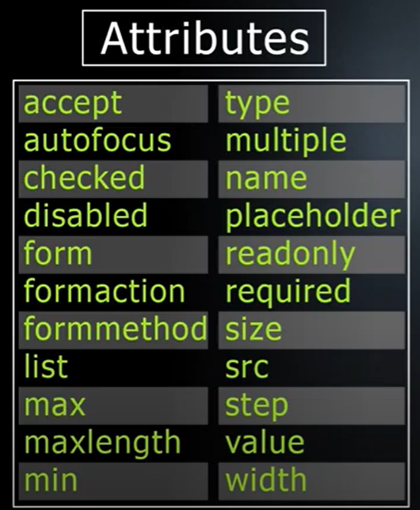
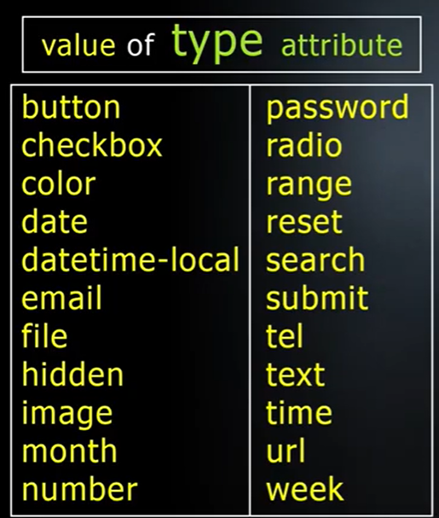
<input> tag
<input> elements are used within <form> element to declare input controls that allow user to input data.
The <input> tag specifies an input field where the user can enter data.

Slide 25
Type- Specifies the type of input element to display.
Text- It is used for general plane text. Defines a single line text field.
Name- Specifies name of the field to the server.
Email- defines field for email.
Password- Defines a password field. (characters are masked)
Tel- Defines a field for entering a telephone number.
Date- defines date control (year, month, date) (no time)
Radio- Radio buttons are normally presented in groups. ( A collection of radio buttons describing a set of related options). Only one radio button in a group can be selected at the same time.
Checkbox- The checkbox is shown as a square box that is ticked (checked) when activated. Check boxes are used to let a user to select one or more options out of choices given.
Submit- defines a submit button which submits all form values to a form handler. The form handler is typically a server page with a script to process the input data.

Slide 26
Time- Defines a control for entering a time. (No time zone)
Date-time local- Defines a date and time control(year, month, day, time) (No time zone)
Month- Defines a month and year control. (no time zone)
Week- Defines a week and year control. (no time zone)
Color- Defines a color picker.
File- Defines a file select field and a browse button. (For file uploads)
Number- defines a field for entering a number. Min attribute specifies minimum count for this and max specifies maximum value.
Range- defines a range control like a slider control.
search- Defines a text field for entering a search string.
URL- Defines a field for entering URL.
Reset- defines a reset button. Clears the filled data of the form.
src- specifies the url of the image to use as submit button. (only for type=“image”.

Slide 27
Accept attribute
The accept attribute can only be used with <input type=“file”>. It specifies the type of file accepted by the server through a file upload.
Autofocus
It specifies that an <input> element should automatically get focus when the page is loaded.
Checked
It specifies that an <input> element should be pre-selected (checked) when that page is loaded.
disabled
It specifies that the <input> element should be disabled. A disabled input element is unusable and unclick able.
form
The form attribute specifies one or more forms the <input> element belongs to.

Slide 28
formaction
The formaction attribute specifies the url of the file that will process the input control when the form is submitted.
The formaction attribute overrides the action attribute of the <form> element.
The foraction attribute is used with type=“submit” and type=“image”
formmethod
The form method attribute defines the HTTP method for sending the form data to the action URL.
The formmethod attribute overrides the method attribute of the <form> element.
The formmethod attribute can be used with type=“submit” and type=“image”.
The form data can be sent as URL variables (method=“get”) or as an HTTP post transaction (method=“post”).
List
The list attribute refers to a <datalist> element that contains pr-defined option for an <input> element.

Slide 29
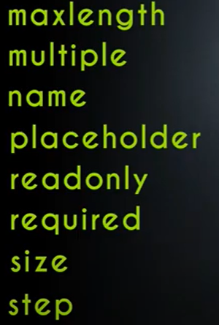
Other attributes of input

Slide 30
maxlength
The maxlength attribute specifies the maximum number of characters allowed in the <input> element.
multiple
It specifies that the user is allowed to enter more than one value in the <input> element.
The multiple attribute works with the following input types: email, file.
For <input type=“file”>: to select multiple files, hold down the CTRL or SHIFT key while selecting.
placeholder
The short hint is displayed in the input field before the user enters a value.
placeholder attribute works with the following input types: text, search, url, tel, email and password.
readonly
It specifies that an input field is read only.
required
It specifies that an input field must be filled out before submitting the form.

Slide 31
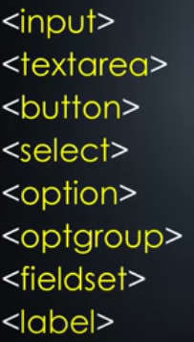
Size
Specifies the width in characters of an <input> element.
Step
The step attribute specifies the legal number interval for an <input> element. Ex- if step=3 legal numbers- -3, 0, 3, 6, 9
<form> tag
The form tag is used to create an html form for user input.
The other tags used with form tag are following-

Slide 32
Attributes of <form> tag
accept-charset
The accept-charset attribute specifies the character encoding that are to be used for the form submission.
UTF-8 Character encoding for Unicode(All characters of the world)
ISO-8859-1 Character encoding for latin alphabets (used in HTML 4 having 256 characters only)
Action
It specifies where to send the form data when the form is submitted.
Autocomplete
It specifies whether a form should have autocomplete off or on.
It is generally used to show previous values filled by the user for any field if on.
Method
It specifies how to send the form data (the form data is sent to a page specified in the action attribute).
The form data can be sent as URL variables using get method but sent using HTTP post transaction with method=post.

Slide 33
URL is limited (get method) (about 2048 characters)
But post has no limitation in size.
enctype
Spaces are converted to “+” symbols but no special characters are encoded.
name
This attribute specifies the name of the form. The name attribute is used to reference elements in a java script or to reference form data after a form is submitted.
novalidate
When present it specifies that the form-data (input) should not be validated when submitted.
Through this the server can know that the form data is not valid.
target
It opens a new tab after form submission is done.

